Slide 1
Information Asset Classification, Handling, and Protection

Slide 2
Index
Types of Information
Medium Risk Data
High Risk data
Roles in admin area

Slide 3
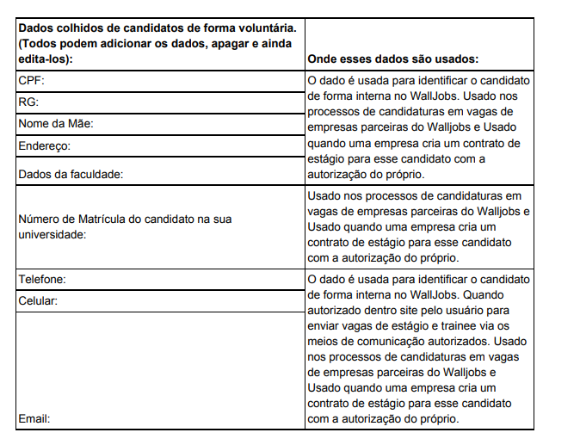
From candidates
Medium risk
Just Customer Success that have the role to attend candidates in WallJobs can have access to this part of the system.

Slide 4
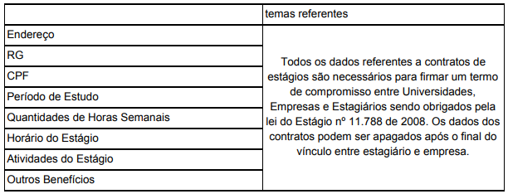
From Interns
Just C-Levels and customer success (focal point with company) can have access

Slide 5
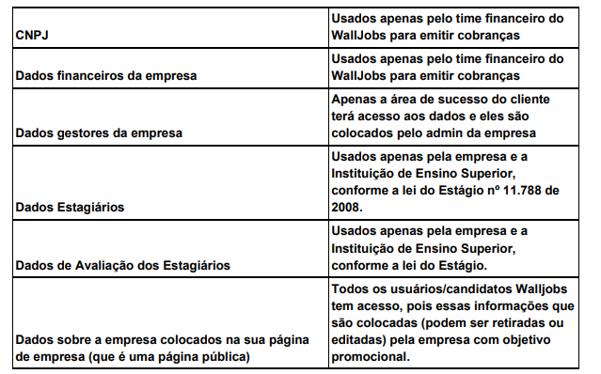
From Companies
High Risk
Just C-Levels and customer success (focal point with company) can have access

Slide 6
Roles of WallJobs Employers
Roles in Admin
Marketing - can access just marketing data in admin - Medium and low risk
Customer Success - can access your customers data in admin - medium risk
Financial - can access financial data in admin - high risk
C-Level (partner)- can access all data in admin - high risk
IT team - can access data that make sense in their tasks, with the authorization of the CTO. - high risk

Slide 7
Serves policy
How our servers handle the information and the protection.
WallJobs uses Herokuapp to support our infrastructure.
Our platform is hostege on herokuapp that uses postgrees that have all compliances processess documented at https://devcenter.heroku.com/articles/security-privacy-compliance

